Slide 1
A Project Overview – “Estimating the accuracy of Moho depth estimates from gravity inversion”
By Aidan Hernaman
Supervised by Leonardo Uieda
University of Liverpool
Notes:
Hi welcome to my project talk entitled “Estimating the accuracy of Moho depth estimates from gravity inversion” and supervised by Leonardo Uieda.

Slide 2
What will be covered in this Overview
Introduction to the problem
Background work already completed
What still needs to be done
How the rest of the project will be completed
Where it fits into current research and future work based off this project
Notes:
This presentation will cover everything about this project including: an introduction to the problem, the background work already completed, what still needs to be done, how the rest of the project will be completed, and where this project fits into current research and the future work that can be done following this project.

Slide 3
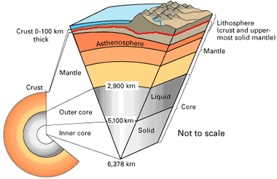
Introduction to the problem
The Mohorovičić discontinuity (Moho) is an inverse problem
Cannot be modelled by observation alone
Needs data to estimate boundary
Many have modelled the Moho such as Assumpção (2013), Uieda & Barbosa (2017), and Reguzzoni (2015)
Almost no models include uncertainties of these Moho estimates
Figure 1- A section of the Earth split into its different components. (Hobart M. King, Mohorovičić discontinuity, Geology.com, viewed 3 January 2021, <https://geology.com/articles/mohorovicic-discontinuity.shtml>)
Notes:
-The Moho or Mohorovičić discontinuity is part of an inverse problem mainly due to its depth beneath the surface meaning that this boundary cannot be physically observed.
-Hence people have resulted in using gravitational, seismological or isostatic data from surveys to estimate this boundary.
-Most models published achieve similar estimates for the Moho however none include uncertainties of these estimates so its difficult to justify if these values are a true representation of the moho.
Notes: say full moho name then refer to it as just moho from then on
Diagram of the Moho

Slide 4
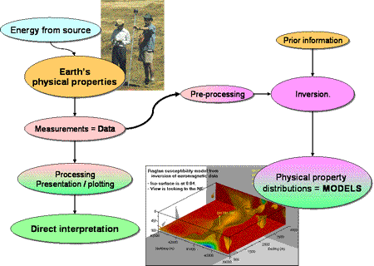
Introduction to the problem
What actually is inversion?
Using data to interpret a physical property
This project uses seismic and gravitational to estimate Moho
Figure 2- A flow chart explaining geophysical inversion. (F. Jones, 2007, Inversion concepts: Introducing geophysical inversion, UBC Geophysical Inversion Facility, viewed 3 January 2021 <https://www.eoas.ubc.ca/research/ubcgif/iag/tutorials/invn-concepts/index.htm>

Slide 5
Background work already completed
Been working on this project since August 2020 and since then have:
Learnt how to use the GitHub website
Background reading on the field
Studied basics of geophysical inversion (linear and non-linear)
A literature review of the current state of the field
Notes:
-I have been working on this project since August of 2020 and since then I have learnt how to use the GitHub website which is where all the code and files for this project are stored. Have competed extensive reading on and around the field for which this has also helped me write a literature review of the current state of the field. Alongside this I have studied the basics of geophysical inversion in the form of both linear and non-linear problems for which this project will be the latter of the two.

Slide 6

Background work already completed
What's the difference between a linear and non-linear inverse problem?
$d_{obs}=F(p)$
F value is constant= Linear
F value not constant= Non-linear
F value is forward map (square matrix)

Slide 7
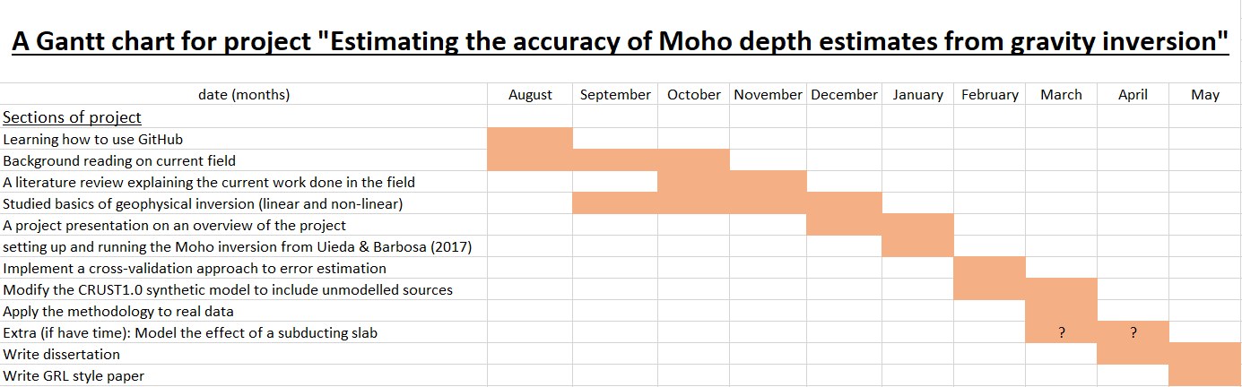
What still needs to be done - a timeline
Have created a Gantt chart to track progress to date and going forward:
Notes:
-Here I have created a Gantt chart or timeline for this project, as mentioned in the previous slide all the things I have already done are shown on this chart. And what I intend to do is too along with a timeframe of when these things will be completed. The question marks indicate a section that may or may not be competed and is time dependent. This will not take anything away from the project if not done but will be the cherry on the cake if it is and works.

Slide 8
How the rest of the project will be completed - a step by step approach
What still needs to be completed based off the Gantt chart:
Setting up and running inversion from Uieda & Barbosa (2017)
Implement a cross validation approach to error estimation
Modify the CRUST1.0 (Laske (2013)) synthetic model to include unmodelled sources
Apply methodology to real data
Extra (time dependent): model effect of a subducting slab
Notes:
-I will now take you through a step by step approach of what is left to do for this project breaking down each step into its individual constituents. Here is a list of everything that needs to be completed and is taken straight from the chart on the previous slide. To begin with the next step is setting up and running the inversion from Uieda & Barbosa (2017).

Slide 9
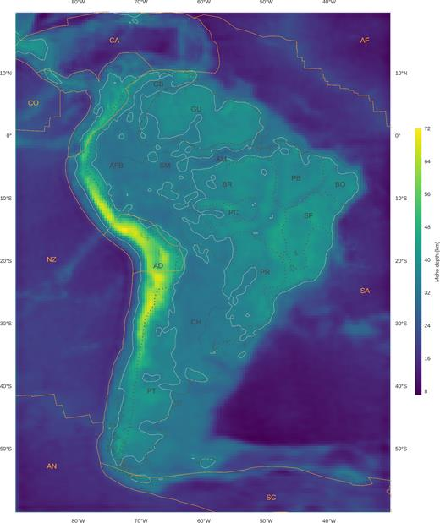
How the rest of the project will be completed - a step by step approach
Setting up and running inversion from Uieda & Barbosa (2017):
Run python code create model of South American Moho
Fix any bugs or glitches
Left is original model from 2017
Figure 3- A Moho depth model of South America from Uieda & Barbosa(2017). Uieda, L. and Barbosa, V.C., 2017. Fast nonlinear gravity inversion in spherical coordinates with application to the South American Moho. Geophysical Journal International, 208(1), pp.162-176.
Notes:
-Setting up and running this code should be pretty straight forward as everything is already written, one challenge that may have to be overcome is the age of the code. With this code being over 3 years old now some minor changes may need to be made as a result of python updates editing how functions and specific code is used, but again this shouldn’t take long and in theory will be straight forward.

Slide 10
How the rest of the project will be completed - a step by step approach
Implement a cross validation approach to error estimation:
Add cross validation into code.
Cross validation is simply using a testing set which is a small sample of the whole data and seeing how well it predicts new data
Cross validation- compare gravitational estimates to seismic point estimates
Do not have seismic estimates for whole continent
Notes:
-The next step is to implement a cross validation approach, in particular hold out cross validation, to error estimation. Cross validation in general is using a testing set to get a model and then inputting unseen data into this model and seeing how well the method predicts the output. Cross validation will help point out under/overfitting and any bias in the data. The cross validation approach I will be using in this project is comparing gravitational estimates from GOCE satellite data to seismic point estimates and calculate and then minimise the mean square error.
-If we had seismic data that spanned the whole continent of South America then there wouldn’t be any need for a gravitational/mixed method approach, this is why this method is being trailed in South America and not say Europe.

Slide 11
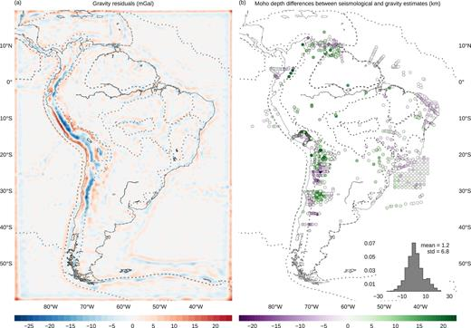
How the rest of the project will be completed - a step by step approach
Modify the CRUST1.0 synthetic model to include unmodelled source/s:
Code from Uieda & Barbosa includes random noise in data
didn’t include unmodelled sources
Modify code to include one or more unmodelled sources
Location of mass anomaly is difficult to pinpoint so will use trial and error
Figure 4- A model of the gravity residuals and differences between seismic and gravity estimates from Uieda & Barbosa(2017). Uieda, L. and Barbosa, V.C., 2017. Fast nonlinear gravity inversion in spherical coordinates with application to the South American Moho. Geophysical Journal International, 208(1), pp.162-176.
Notes:
-The next step is to modify the CRUST1.0 synthetic model to include unmodelled source/s. The code from Uieda & Barbosa includes random noise in the data, however didn’t include unmodelled sources as they are completely unknown. Based off the results of their model it is clear that there are one or more unmodelled masses which will be added into the code as a form of either sedimentary basins or underplating.
-The location of the mass anomaly will be difficult to pinpoint so will have to use a trial and error approach to this problem to estimate the rough area where the source may be.
-Non-uniqueness comes into effect here as multiple models with different mass anomalies can produce the same final result. So it will be difficult to pick one result over others if the exact same model is produced.

Slide 12
How the rest of the project will be completed - a step by step approach
Apply methodology to real data:
Based off success of hold out cross-validation method can apply method to real data.
For instance can use South American data that Uieda & Barbosa (2017) used
Or could use new data sets such as Africa or Antarctica
Notes:
-The penultimate section is to apply this method to real data. Based off the cross validation approach used to predicting unseen data this method can be applied to real data, this could either be for data used by Uieda & Barbosa in their 2017 paper for South America or other data sparse continents such as Africa or Antarctica.

Slide 13
How the rest of the project will be completed - a step by step approach
Extra (time dependant): model effect of a subducting slab
Uieda & Barbosa (2017) model does not account for subducting Nazca plate just estimates it
Use Slab2 model to model the effect of this subducting slab
Assume crust and lithosphere thickness as priori data and calculate effects with tesseroids
Finally calculate how much it contributes to uncertainty of Moho depth
Notes:
-The final step and added extra is to model the effect of a subducting slab. The Uieda & Barbosa model does not account for subducting Nazca plate under South America it just estimates it.
-To do this I would use Slab2 which will help model the effect of this subducting slab.
-In order to use this to model the slab then the crust and lithosphere thickness would need to be known beforehand, priori data, and as the rest of the code uses tesseroids the Slab2 model would need to be adjusted to take this into account.
-Finally to see how much of an effect this has on the overall result I’ll calculate how much it contributes to the uncertainty of Moho depth.

Slide 14
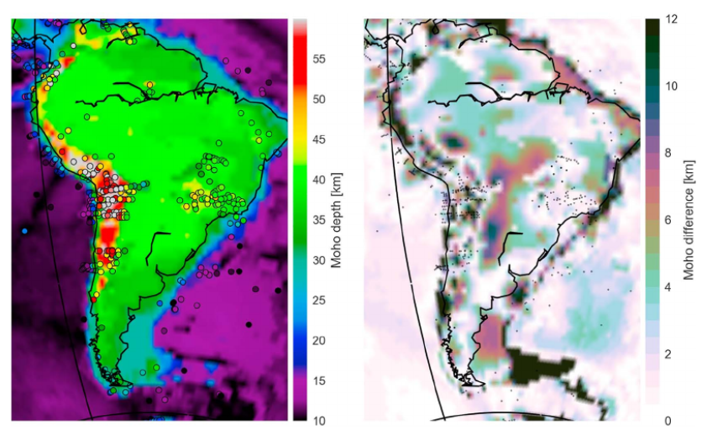
Where this project fits into current research
Many people have produced Moho models of South America
few have included uncertainty estimates
Szwillus (2019) included uncertainty estimates in their model by using residual topography
Almost no papers have used approach of hold out cross-validation
Figure 4- Uncertainty estimates of South America based off residual topography and interpolation. Szwillus, W., Afonso, J.C., Ebbing, J. and Mooney, W.D., 2019. Global crustal thickness and velocity structure from geostatistical analysis of seismic data. Journal of Geophysical Research: Solid Earth, 124(2), pp.1626-1652.
Notes:
-many people have produced Moho models of the continent of South America however few have actually included uncertainty estimates, something that has already been mentioned in the introduction to the problem.
-Szwillus included uncertainty estimates in their model of South America by using the residual topography and interpolation and that model can be seen on the left.
-Even though some papers such as Szwillus have tried to estimate uncertainty however almost none have used this approach of using hold out cross-validation.

Slide 15
Possible future work that can be carried out from this project
Adding a variable density contrast
In many papers a single density contrast is used for South America which isn’t geologically correct but does make coding easier
Can implement multiple density contrasts
May change how the unmodelled masses are estimated as well as reduce overall error
Notes:
-one avenue that could be explored is adding a variable density contrast to the code.
-A single density contrast is used for many papers as it leads to an easier code even though the geological aspect isn’t technically correct.
-In many papers such as Van der Meijde (2013a) (model= GMSA12) a multiple density contrast is used and splits South America up into 14 geologically distinct areas and created a model based of these differences. So implementing this approach to the code could reduce the overall error and uncertainty of the model estimates.

Slide 16
References
Assumpção, M., Feng, M., Tassara, A. and Julià, J., 2013. Models of crustal thickness for South America from seismic refraction, receiver functions and surface wave tomography. Tectonophysics, 609, pp.82-96.
Laske, G. et al. (2013) CRUST1.0 A New Global Crustal Model at 1x1 Degrees [Online]. Available at: https://igppweb.ucsd.edu/~gabi/crust1.html (Accessed 18 November 2020)
Reguzzoni, M. and Sampietro, D., 2015. GEMMA: An Earth crustal model based on GOCE satellite data. International Journal of Applied Earth Observation and Geoinformation, 35, pp.31-43.
Szwillus, W., Afonso, J.C., Ebbing, J. and Mooney, W.D., 2019. Global crustal thickness and velocity structure from geostatistical analysis of seismic data. Journal of Geophysical Research: Solid Earth, 124(2), pp.1626-1652.
Uieda, L. and Barbosa, V.C., 2017. Fast nonlinear gravity inversion in spherical coordinates with application to the South American Moho. Geophysical Journal International, 208(1), pp.162-176.
Notes:
Just a list of references

Slide 17
Discussion/Questions?
Notes:
Any Questions?/Discussion time

Slide 18
Notes to add
Take out sentences really short bullet points
Add lit rev stuff
Leos lectures stuff
Explain what Tesseroid use means- large area so cannot consider surface to be flat.

